Slide 1
The NCSC Model for a Comprehensive System of Curriculum, Instruction and Assessment
August 2014

Slide 2
Background

Slide 3
Alternate Assessment Background
States are required to have assessments to measure student performance for accountability purposes in math and English Language Arts for grades 3-8 and once in high school
There are alternate assessments for students who have the most significant cognitive disabilities
These assessments are linked to grade level content but have different expectations for achievement
They are referred to as alternate assessments on alternate academic achievement standards (AA-AAS)
Notes:
IDEA required states to have alternate assessments for students who could not take the general state assessment even with accommodations. ESEA regulations in 2003 elaborated on the criteria for the assessment and on the eligibility rules for students.

Slide 4
NCSC Background
The U.S. Department of Education awarded the National Center and State Collaborative (NCSC) a grant to develop a new alternate assessment in math and English Language Arts by 2014-15*
24 states and five national centers are working together in NCSC http://www.ncscpartners.org/
NCSC is also developing curriculum/instructional resources based on Common Core State Standards (CCSS) that can be used in any state https://wiki.ncscpartners.org
*states may have different implementation timelines for
NCSC assessment
Notes:
CCSS will be discussed in next slide.

Slide 5
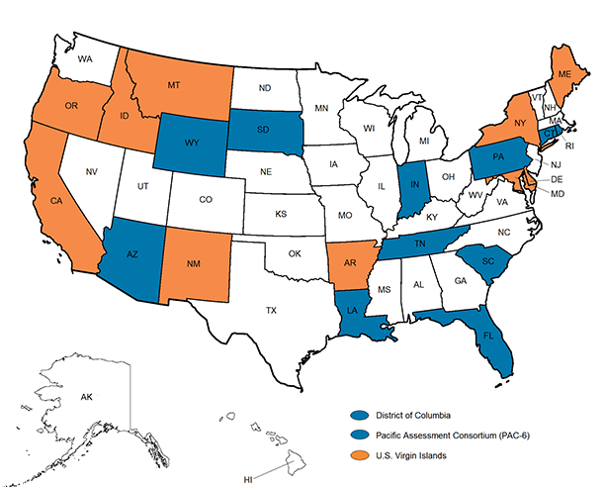
NCSC Partner States

Slide 6
Common Core State Standards (CCSS)
Define what students are expected to know and do for each grade level in math and English language arts (ELA)
Focus on what is most essential, not all that can or should be taught or “how” to teach
Are linked to expectations for college and career success
Most states have adopted the CCSS and must provide instruction and assessments for ALL students based on these standards.
The other states have similar college and career ready standards and related assessments
Notes:
NCSC promotes an opportunity to ensure that students with the most significant cognitive disabilities benefit from the national movement toward Common Core State Standards designed to prepare all students for success in college and careers (and community).
NCSC supports educators as they plan for and provide appropriate instruction that is based on the Common Core State Standards (CCSS) in English Language Arts (reading and writing) and mathematics in grades K – 8 and high school.
The Common Core State Standards intentionally leave room to determine how academic goals should be reached and what additional topics should be addressed.
The Curriculum and Instruction (C & I) resources provide evidenced-based strategies and tools to support how to teach this content that are based on over a decade of research on academic instruction, communication, and learner characteristics of students with the most significant cognitive disabilities.

Slide 7
NCSC’s Value in States Without CCSS
The main focus of any set of academic standards addresses similar content in math and ELA (e.g. equations, elements of fiction)
The NCSC resources are not meant to “be” the curriculum – they are models of curriculum and instructional resources that happen to be based on the CCSS
These models also demonstrate how to develop curriculum and instructional resources based on whatever standards a state is using
The richness of the NCSC resources for students with significant cognitive disabilities and their usefulness for professional development are valuable in any state

Slide 8
National Center and State Collaborative
Grant: A Systems Approach
Building an assessment system based on research-based understanding of:
Technical quality of Alternate Assessment design
Formative (throughout the year as part of classroom instruction) and interim (multiple times a year, may be separate from instruction) uses of assessment data
Summative (end of year) assessments
Academic curriculum and instructional resources for students with significant cognitive disabilities
A focus on communicative competency
Effective professional development

Slide 9
Career
College
Community
Curriculum
Common Core Standards
Learning Progressions
Core Content Connectors
Instruction
Grade-level Lessons
Accommodations
Systematic Instruction
Assessment
Formative, Interim
Summative
Communicative Competence
Notes:
The NCSC partners share a common commitment to the development of a comprehensive system of supports that reflects a necessary shift in teaching and learning practices by teachers for students with the most significant cognitive disabilities participating in Alternate Assessment – Alternate Achievement Standards (AA-AAS)
NCSC embraces a research-to-practice approach. It recognizes that to build academic competence of students with the most significant cognitive disabilities, it must support teachers in building their understanding the Common Core States Standards and how to teach these standards using evidence-based instructional resources and systematic learning strategies and models, and following the pathways of the Learning Progression Framework. In addition, the project must address the learning characteristics of students who participate in AA-AAS and how students with significant cognitive disabilities build academic competence.
To be fair to students and teachers, the model of student learning and cognition that teachers use during instruction and in their classroom assessments must be the SAME model that assessment developers use in designing the NCSC summative assessment.
This knowledge and support must be delivered to teachers through a comprehensive approach of sustained, professional development.
To this end, the project partners are developing a range of research-to-practice, evidence-based resources and trainings to support teachers as they plan for and provide instruction (in collaboration with other teachers to support instruction in a variety of educational settings), that is based on the Common Core State Standards.

Slide 10
College and Career Readiness

Slide 11

Cross Walking College and Career Readiness
All kids
  Key Cognitive Strategies
    Problem solving, reasoning, analysis, interpretation, critical thinking
  Key Content
    Reading, Math, Science, Social Studies
  Academic Behaviors
    Self monitoring, time management, using information resources, social interaction skills, working in groups
  Contextual Skills and Awareness
    Seeking help with admissions, procedures, career development
        (Conley, 2007)
Students with Significant Cognitive Disabilities
  Academic Access
  Career Development
  Social Network
  Self Determination
  Integration with College Systems & Practices
  Coordination and Collaboration
Notes:
You can see the clear relationship between college and career readiness skills that apply to all students and the skills that students with significant cognitive disabilities need for successful post-school outcomes.

Slide 12
Key College and Career Ready Skills
Important for ALL students including those with significant cognitive disabilities:
Communicative competence
Social skills to function well in small groups
Independent and team work skills
Problem Solving
Reading/writing/math
Skills for identifying and requesting supports
Notes:
Communicative competence means to come to school with a communication system that enables the student to express personal needs and share information, ideas, questions, and comments about daily life and the world in which they live. Communicative competence is necessary in order to have access to the curriculum.

Slide 13
Working towards College and Career Readiness in English Language Arts is Important for ….
  Communicating with family, friends, support staff, medical personnel, co-workers, etc.
  Comparing information to make decisions (including voting)
  Self-determination and self-advocacy
  Traveling in the community
  Understanding books, movies, TV shows and songs
  Attending college
  Finding and maintaining employment
Notes:
Regardless of student’s ability level or post-school goals there are benefits that can be derived from academic instruction.

Slide 14
Working towards College and Career Readiness in Math is Important for…
Telling time
Making and following a schedule
Managing money
Arranging and using transportation
Taking medication
Planning and making meals
Shopping
Attending college
Finding and maintaining employment

Slide 15
Increasing Numbers of Students with Intellectual Disabilities Are Going To College
The Higher Education Opportunity Act (2008) includes two major provisions that may facilitate entry into higher education for students with an intellectual disability.
  Implementation of model demonstration sites
  Availability of financial aid if enrolled
See www.thinkcollege.net for more information on the variety of programs that have been developed (many before 2008)

Slide 16
NCSC Curriculum and Instructional Resources https://wiki.ncscpartners.org

Slide 17
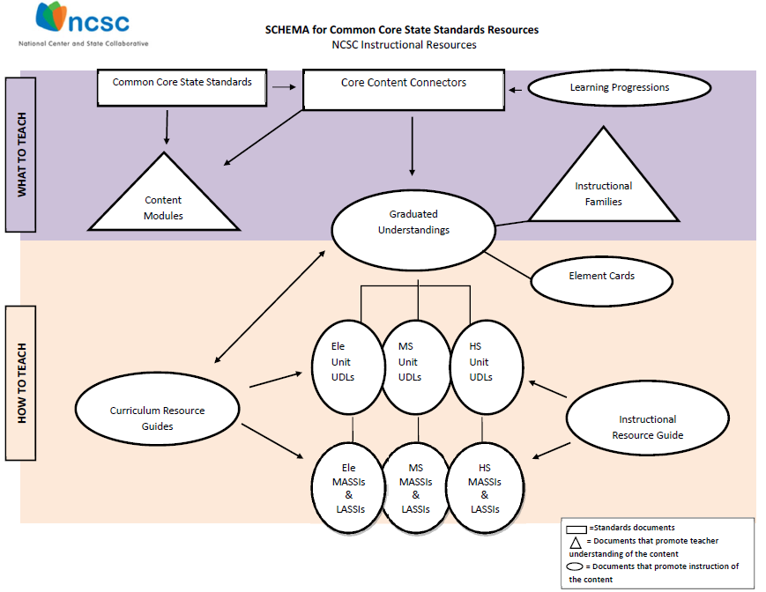
Notes:
Over the past several decades, powerful insights have been gained into how students represent knowledge and develop competence in specific domains, as well as how tasks and situations can be designed to provide evidence for inferences about what students know and can do for students across a full range of performance.
To provide evidence of student learning consistent with the increased expectations of the CCSS, the NCSC instructional resources schema defines the “what” and “how” when planning for and teaching academic content to students with the most significant cognitive disabilities.
In the schema, the purple band describes the “what to teach” containing the Common Core Sate Standards, the Core Content Connectors and the Learning Progressions.
In the schema, the orange band identifies instructional tools to support how to teach this content - based on over a decade of research on academic instruction, communication, and learner characteristics of students with the most significant cognitive disabilities.

Slide 18
Importance of NCSC Resources
Provide educators with free online curriculum and instructional resources to support planning and instruction on the grade level content for students who take the alternate assessment
Provide tools to help educators meet the needs of a wide range of learners, including those who are emerging communicators and emerging readers
Support inclusive education, co-teaching and collaborative planning
Support parents as partners in their child’s education

Slide 19
Learning Progressions Framework (LPF)
Shows the steps students typically take to make progress in a content area (e.g. math) to get deeper, broader, more sophisticated understanding
Represents the essential core concepts and processes learned in a content area (sometimes called the “big ideas”)
Provides a map to IEP teams for what should come next as students continue to move through the grades
Contains progress indicators
Hess, Karin K., (December 2011). Learning Progressions Frameworks Designed for Use with the Common Core State Standards in English Language Arts & Literacy K-12.
Notes:
This project uses a developed learning progression framework (Hess et al., 2010) in ELA and math to inform what content is taught as well as the stream of content that helps students reach the concept/big idea;
The LPF is a hypothesized pathway that typical peers may take, and is meant to inform what typical peers will be working on grade by grade. In the past, we have struggled to understand how to choose content grade by grade to ensure inclusion of students with the most significant cognitive disabilities in grade AND age appropriate content even though they may not have built all the skills in a previous grade.
The LPFs give us the educational logic to help move these students along with their peers in a logical, educationally sound way.
The LPF contain learning targets and progress indicators that are referenced in C & I materials.
Learning targets(general/broad performance descriptors) are defined by grade spans, K-4, 5-8 an high school.
The related specific skills and concepts are called the progress indicators (PIs).
The Curriculum and Instructional materials were developed to help promote how students can engage in the CCSS while following the learning progressions.

Slide 20
Core Content Connectors (CCCs)
Using the learning progressions framework, NCSC identified the knowledge and skills from the Common Core State Standards needed at each grade to make progress in later grades-the “big ideas” of the content
These “big ideas” were then broken down into smaller pieces called CCCs
CCCs are the basis for the NCSC assessment but operate as a starting point for instruction based on the CCSS
Notes:
The CCCs represent academic content designed to frame the instruction and assessment of students with the most significant cognitive disabilities in Kindergarten through high school while retaining the grade level content focus of the CCSS and the LPFs.
The CCCs preserve the sequence of learning outlined in the LPF to the extent possible while identifying the basic parts of the progress indicators into teachable and assessable segments of content.

Slide 21
CCC Example
CCSS- Read closely to determine what the text says explicitly and to make logical inferences from it; cite specific textual evidence when writing or speaking to support conclusions drawn from the text.
CCC- Ask and answer questions* about key details in a text.
*Instead of an oral or written response, some students may use picture symbols, character figures and props, etc.

Slide 22
Learning Progression Framework
Curriculum Application
Lesson 5
Area
Find area of quadrilaterals
Find area of plane figures and surface area of solid figures (quadrilaterals)
Describe the changes in surface area, area, and volume when the figure is changed in some way (e.g., scale drawings)
Graphing
Locate the x and y axis on a graph
Locate points on a graph
Use order pairs to graph given points
Solve Linear Equations
Solve a linear equation to find a missing attribute given the area, surface area, or volume and the other attribute
Fractions
Partition circles and rectangles into two and four equal parts
Partition shapes into equal parts with equal area
Ratio & Proportion
Solve problems that use proportional reasoning with ratios of length and area
Describe the changes in surface area, area, and volume when the figure is changed in some way (e.g., scale drawings)
Apply formulas
Solve word problems using perimeter and area where changes occur to the dimensions of a figure
CCCs = that connect skills
Area
Use addition to find the perimeter of a rectangle
Use tiling and multiplication to determine area
CCCs=Sub-skills that develop conceptual understanding
Basic operations
Addition
Subtraction,
Multiplication
Division
CCCs =Prerequisite knowledge or emergent skills
Part to Whole
Partition circles and rectangles into two equal parts
Notes:
This slide is an example of how CCCs can be combined in a lesson to deepen and broaden understanding for a broad range of learners, starting with CCCs for prerequisite and emergent skills and knowledge working up to CCC’s that connect skills.
Instructional Families represent “bundles” of related CCCs that have a common instructional basis. Hence, these bundles may be taught within a an Instructional Unit. It is critical to use a holistic approach to teaching the CCCs rather than a discrete or one-by-one checklist approach.

Slide 23
Content Modules
Online multimedia resources
Provide teachers with a deeper understanding of content to support effective planning, teaching, and learning
Include sample universally designed general education lesson plans
Describe potential adaptations and modifications for designing materials and instruction

Slide 24
Graduated Understandings
Instructional Families (What to Teach):
  Bundle related CCCs within a content area
  Provide educators with easily interpreted visual representations of the key topics in the curriculum within and across grades
  Reference the CCSS, the Learning Targets of the Learning Progression Frameworks and the Core Content Connectors
Element Cards (How to Teach):
  Reference the CCSS, Core Content Connectors and Progress Indicators
  Define the Essential Understandings (what a student needs to know to access the content)
  Provide suggested instructional strategies, supports and scaffolds
Notes:
The Instructional Families define the “what” – organizing the Core Content Connectors in easily interpretable visuals that illustrate how related CCCs are emphasized within a subject area
The Element cards, when used in combination with other NCSC CCSS instructional tools, define the “how” by providing ways in which teachers can address grade-specific academic content for students with significant cognitive disabilities, even if students have not had an opportunity learn this content previously.
These tools:
Are to be used in conjunction with rich instructional resources (e.g., NCSC instructional resources, etc.) as indicated on the schema;
Provide challenging and attainable content that is observable and measurable for use in instruction and a thorough system of assessments;
Provide guidance on how to “unpack” the instructional and assessed content; and
Promote suggested instructional strategies, supports and scaffolds for teaching challenging academic.

Slide 25
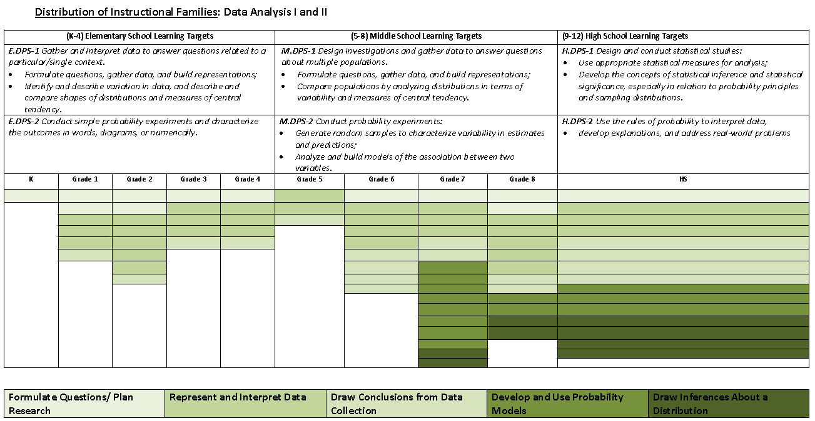
Grade-span Learning Targets from the Learning Progression Frameworks
Distribution of Instructional Families and the number of related CCCs by grade
Five Instructional families for Data Analysis I & II
Notes:
The first view of the instructional families is a chart that illustrates the distribution and changes in emphasis of the core content, knowledge and skills that students with the most significant cognitive disabilities are expected to learn at each grade to promote success in the next grade and to reach the learning targets within the LPF and the CCSS.
As shown, the distribution of families and the number of CCCs in each family in a domain by grade clearly varies across grades k – high school.
This sample view of Data Analysis I and II (DPS-1 and DPS-2) also connects the learning targets of the Learning Progressions Frameworks to the distribution of the Instructional Families and CCCs. Note that the Learning Targets become more sophisticated as you move up through the grades and that the emphasis (distribution of instructional families) changes as well.
Students are expected to build their knowledge and be successful with more challenging concepts across the grade levels (for example, from representing and interpreting data toward drawing inferences about a distribution of data). Student mastery of skills at each grade level promotes student learning of more challenging concepts.
The view shows the distribution and emphasis of the five instructional families and the number of related CCCs for Kindergarten through high school. For example, in grades 7 – HS, all five of the instructional families are indicated where as in grade 5, two instructional families are included.
Given that students may receive instruction in multi-grade classrooms, a teacher can quickly see where there is an “overlap” of instructional families across grades. The teacher can then plan instruction that addresses related content within and across families at appropriate levels of instruction for different students within the same lesson.

Slide 26
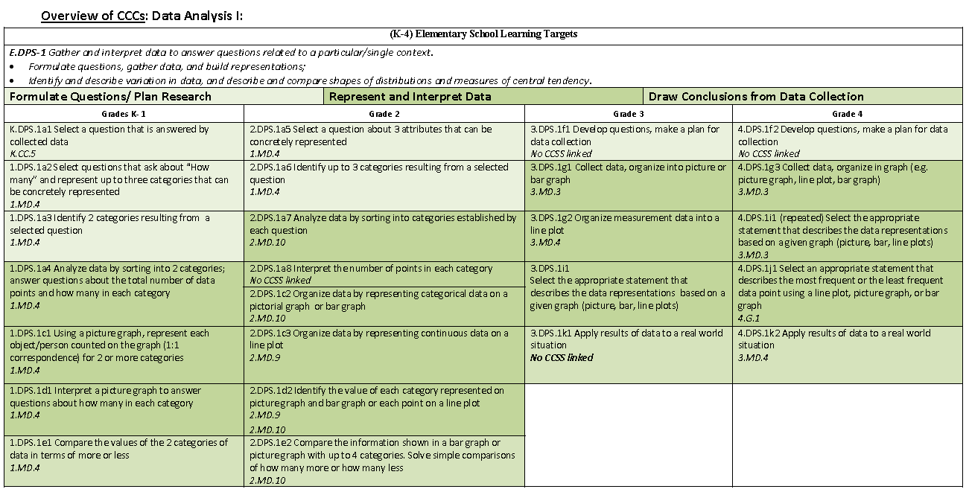
Grade-span Learning Target from the Learning Progression Frameworks
Instructional Families for Data Analysis I (K-4)
Reference to related CCSS
Distribution of CCCs by Instructional Families an grade
Notes:
This view of the instructional families illustrates the distribution of families and the specific CCCs in each family by grade-band (K-4). It also reflects the instructional families and CCCs’ relationship to the learning progressions by demonstrating the relationship to the elementary grade band learning target (big ideas). Additional charts in this view illustrate the overview of the CCCs by grade-bands 5 – 8 and high school.
There is a difference in the number of CCCs within a family within and across the grade levels. It clearly shows the instructional family emphasis and specific CCCs within and across grades K - 4.
In this example of the CCCs chart, the specific CCCs are indicated by families in the Strand of Data Analysis I (DPS-1).
Three of the Instructional Families in Data Analysis, Formulate Questions/ Plan Research; Represent & Interpret Data and Draw Conclusions from Data Collection, are shown. Notice the relationship between the three families at the five grade levels (K-4).
There is a difference in the number of CCCs within a family within and across the grade levels.
Note that for each CCC, there is a reference to the CCSS.
Provide language around the model and why all is this – how the pieces go together; add language that Mariel said;

Slide 27
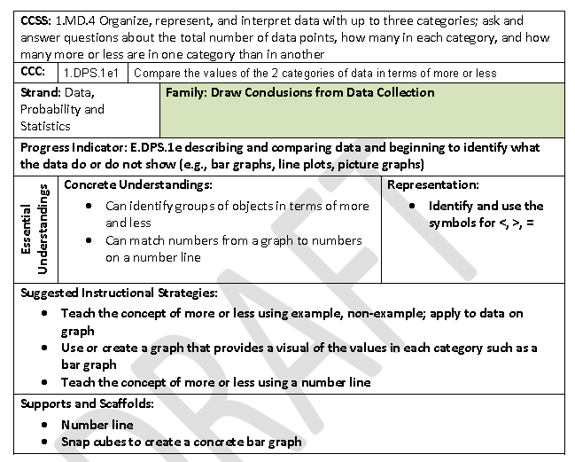
Element Card Sample
Notes:
This is a sample of an Element Card that details its structure and content. Now let’s take a closer look at the element card. (Please note: the fifth module in the suite of the Mathematical Graduated Understandings describes in great detail the purpose, content, and use of the Element Cards).
The first component of the Element Card is the CCSS: This is the Common Core State Standard on which the CCC is based. For this particular card, we can see that the CCSS is the 1st grade, Measurement and Data standard #4;
The second component is the Core Content Connector: The nomenclature used to identify the CCC is followed by a statement of the grade-specific CCC.
The third row provides the related LPF Strand followed by the Instructional Family that contains this CCC. In this example, the instructional family is Draws Conclusions from Data Collection.
The next row on this slide denotes the related Progress Indicator of the LPF. The Progress Indicator related to this particular CCC is Data, Probability and Statistic (DPS)-1e.
The next row contains the Essential Understandings including Concrete and Representation.
Mathematical Concrete:
Fundamental mathematical concepts and skills to address the content described in the grade-level CCCs.
Mathematical Representation:
Specific symbols or referents related to the concepts and skills to apply when problem solving (e.g., mathematical symbols and operations of addition, subtraction, multiplication, division, fractions, equations).
The final two rows provide examples of strategies and supports/scaffolds for teaching the concepts and skills found within the CCC:
The Suggested Instructional Strategies section provides examples of evidenced-based strategies supporting instruction at varying levels of challenge; and
The Supports and Scaffolds section provide suggestions of possible tools and materials that assist in the promotion of understanding and engagement with concepts. These suggested supports and scaffolds can provide a way for students to demonstrated what they know and can do.

Slide 28
Curriculum Resource Guides
Provide guidance for teaching the CCSS to students with the most significant cognitive disabilities
Delineate the necessary skills and knowledge students need to acquire/master the content
Provide examples for differentiating instruction for a wide range of students in multiple grade levels (including a UDL table)
There are downloadable CR Guides for many math and ELA topics
Notes:
The Curriculum Resource Guides help teachers to better understand how to teach the CCCs.
Both the Content Modules and Curriculum Resource Guides were developed and validated by content experts and special educators with extensive experience in adapting general curriculum for students with significant cognitive disabilities.
The Curriculum Resource Guides describe how to teach the content to students with the most significant cognitive disabilities whereas the Content Modules describe the mathematics content (what is being taught) in general education.
Together, the Content Modules and the Curriculum Resource Guides provide teachers with the necessary background knowledge to prepare students for the NCSC alternate assessment and offer examples of how the content is taught in general education, ideas for real life use, examples of universal design for learning, and ways to promote college and career readiness.

Slide 29
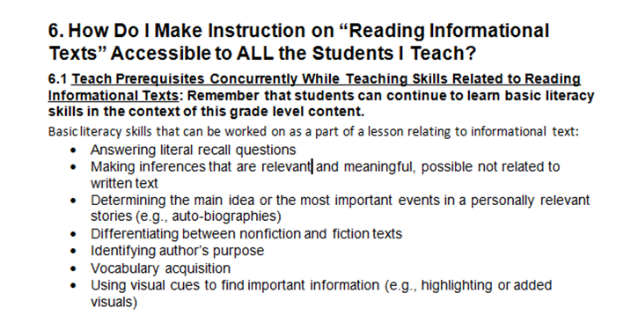
How UDL is incorporated in ELA Curriculum Resource Guide

Slide 30
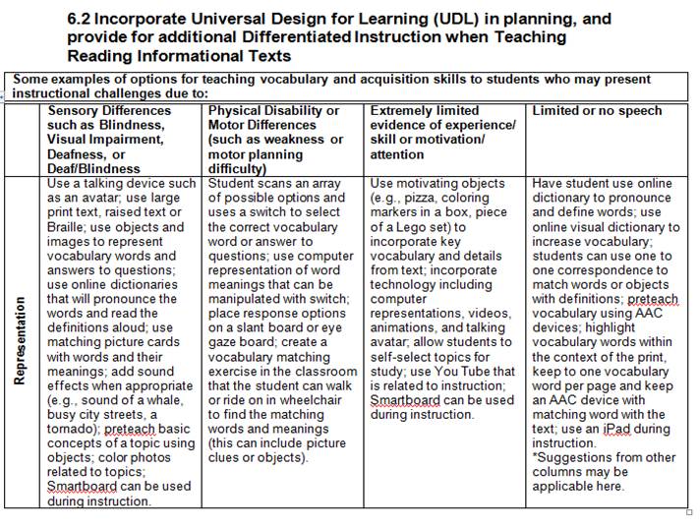
Example of UDL Table in ELA Curriculum Resource Guide

Slide 31
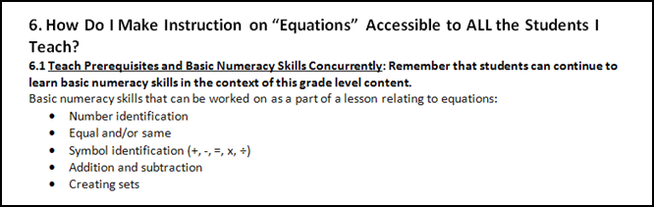
How UDL is incorporated in Math Curriculum Resource Guide

Slide 32
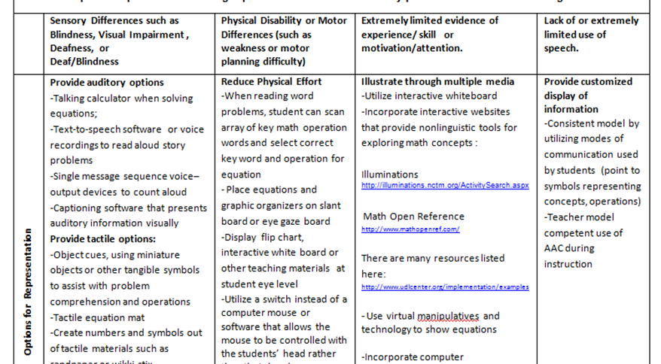
Example of UDL Table in Math Curriculum Resource Guide

Slide 33
Curriculum Resource Guides
Notes:
Example of sample materials provided

Slide 34
UDL Units and Lessons
Purpose: to model how to plan for ALL students from the onset of instructional planning using the principles of universal design for learning (UDL-students should be provided with multiple means of engagement, representation and expression)
Promote inclusive instruction but should also be used to inform lessons in special education classes
Excellent for co-teaching and collaborative planning
Are modified/adapted for Emerging Readers and Emerging Communicators
Notes:
The lessons follow a learning progression to ensure the student has been taught the skills needed. Lesson one begins with a review and practice of foundational or prerequisite skills. This is an important step for students who may not have been instructed on this concept or have not yet become proficient. The steps outlined to develop the necessary skills and knowledge are then used within the entire unit, so that the student has repeated practice throughout. Other concepts taught and used throughout the unit are stressed as necessary to ensure chunking of content knowledge for generalization of the skills and concepts.
Each unit is composed of multiple lessons. Each lesson consists of the following components:
Materials and Vocabulary
Lesson Introduction
Build background knowledge
Review of Lesson objectives
Body of the Lesson
Practice
Closure
Review of Lesson Objectives
Exit Assessment (Formative Assessment)

Slide 35
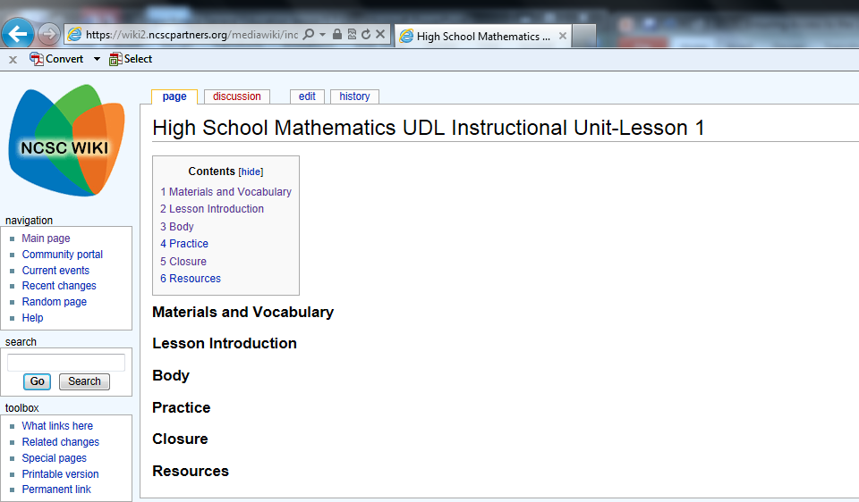
Lesson 1: Introduction – 10 minutes
A. Activate Previous Knowledge
Lead a short discussion about how to find perimeter and area of rectangles.
  Review with students the concepts of perimeter and area.
  Discuss how these concepts are used in real life examples.
    Example 1: A runner is practicing by running along the fence line of a parking lot. Is he running the perimeter of the parking lot or is he running the area?
Example 2: The school is getting new carpet in the classroom. Will the workers need to figure out the area of the classroom or the perimeter?
  Break class into small groups to answer exercises.
Using figures (rectangles and squares) drawn on grid paper or formed on Geoboards, find the perimeters and areas.
Remind students that answers should/must include the appropriate units of measure.
Multiple means of representation: Use models and/or drawings during large group instruction. Allow students to have a copy of a drawing or a model at their desks.
Multiple means of expression: Provide a list of formulas to determine area and perimeter or provide options for using manipulatives and/or computer models.
Multiple means of engagement: Allow students to use paper/pencil, manipulatives, computer, etc. to complete exercises.
Notes:
An example of a page of the wiki for UDL Lessons

Slide 36
Find the perimeter of the figure below.
6u + 6u + 5u + 5u =
22u
6 units
1
2
3
4
5
6
22
7
21
8
5 units
20
9
19
10
18
11
17
16
15
14
13
12
Notes:
Lesson 1
Introduction: Activate Previous knowledge

Slide 37
Find the area of the figure below.
6u x 5u =
30u²
6 units
5 units
5
10
15
20
25
30
Notes:
Lesson 1
Introduction: Activate Previous knowledge

Slide 38
Additional Considerations for Emerging Readers and Emerging Communicators
Provide picture and/or tactile representations of relevant vocabulary, paired with the written word, each time a salient concept/vocabulary word for rectangle, area, and perimeter is mentioned during the presentation or discussion, as well as the meanings of each word. Create math journals to record vocabulary, formulas, and notes. Provide the formulas for area and perimeter as the concepts of each are discussed. During discussion, provide picture representation of real world uses for area and perimeter. As students work in small groups or pairs, ensure they have a means for gaining their group members’ or partner’s attention and a means for contributing to the discussion. Students may use their math journals or a graphic organizer to collect/store information gathered during group. To find area and perimeter, use grid paper, count/mark/tally each unit along the length of the figure to determine length and count/mark/tally each unit along the width of the figure to determine the width. Use the formulas to determine area and perimeter. A list of formulas may be used by the student as a reference. Student may be presented with manipulatives of a unit and the rectangle drawn on grid paper. Students determine area and perimeter by placing the manipulative units on each unit around the rectangle on the grid paper to demonstrate perimeter as well as within the rectangle to demonstrate area. Using manipulatives may be demonstrated electronically, using a computer program or PowerPoint, to count units virtually to determine area and perimeter. See Resources: See PowerPoint, Slides 1 and 2. As answers are reviewed, be sure to reference the appropriate units of measure. For example, if students determine the perimeter of a 3inch by 4inch figure is 14, reply, “That is correct. It is 14 inches.” If they determine the area is 12, reply, “That is correct. It is 12 inches square.” Remind students to record the appropriate unit. Model how to write the appropriate units. Present students with an alternative representation of unit to record in their math journals or graphic organizers. Important Note for Communicators Considered Pre-Symbolic: Be sure students have a way to attain peer attention as well as to share and receive information. Limit measurements to one type: standard or metric unit.
Notes:
Sample of additional considerations that appear throughout the UDL lessons.

Slide 39
Math/ Language Activities for Scripted Systematic Instruction (MASSIs and LASSIs)
Provide more intensive instruction on key concepts and symbols
Incorporate evidence-based instruction from research, including faded prompting
Provide teaching scripts for teachers who may not have a lot of training in systematic instruction, which uses carefully planned steps
Can be used in all educational settings, including general education classrooms
Notes:
The MASSIs/LASSIs offer intensive instruction based on evidence-based practices known to be effective in teaching skills to mastery for students with the most significant cognitive disabilities.
They identify the concepts and symbols needed to move toward mastery of the Core Content Connectors.
Using scripts, the MASSIs and LASSIs present instruction in grades bands 3-5, 6-8 and high school and help teachers plan and prepare for instruction with suggested teacher and student materials.
They offer a guide for instruction with graduating levels of difficulty – ranging from the first steps of teaching the content to students with little or no understanding of the content to building understanding of the target concepts of the CCCs using real-life word problems and using hand-on activities aligned to grade-level content.
After teaching the UDL Instructional Units and utilizing the MASSIs and LASSIs as appropriate for individual students, teachers will gain practice in instructional strategies that are effective for teaching content to students with the most significant cognitive disabilities.

Slide 40
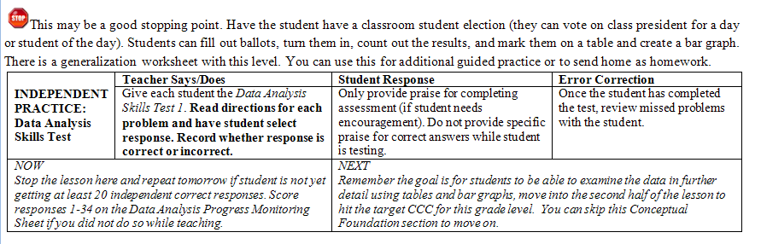
What is Included in a MASSI?
Broken down into segments to teach across multiple sessions/days;
Indicates suggestion for stopping places ;
Shows how to administer skills test (teacher says/does, student response, and error correction); and
Provides suggested criterion for moving forward
Notes:
MASSIs cover a lot of material and are intended to be taught over multiple days.
The stops signs are suggested stopping points in the lesson. These stopping points also indicate that it is time to administer a skills test, which corresponds to the part of the MASSI just taught.
The skills test is another form of progress monitoring, and also helps prepare students for an alternate assessment format.

Slide 41
Instructional Resource Guide
Provides overview of systematic instruction
Explains instructional strategies and faded prompts used in MASSIs and LASSIs
Contains troubleshooting Q&A

Slide 42
Professional Development
Communities of Practice in partner states received professional development about the curriculum and instructional resources via webinars that are publicly available at http://www.ncscpartners.org/resources-cop-presentations
States will also have access to interactive professional development modules

Slide 43
Educator Response
Sample quote:
“I have had the pleasure of observing several classrooms across the state of Indiana where NCSC materials are being implemented on a daily basis. Wow! The impact is powerful, students are responsive, and teachers are dedicated to increased academic achievement.”
Amy Howie, Project SUCCESS* Director
*Project SUCCESS is an Indiana resource center that supports high academic achievement for students with disabilities.

Slide 44
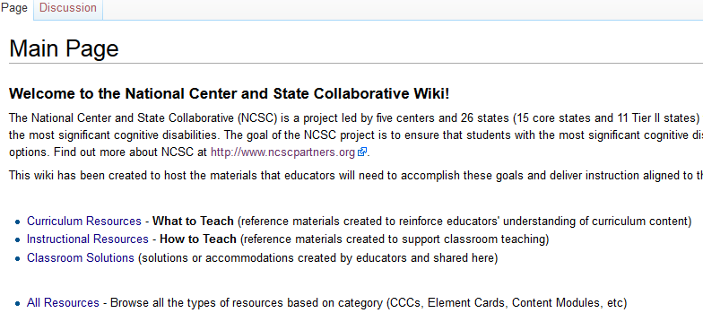
NCSC Wiki https://wiki.ncscpartners.org
Notes:
This is where all the NCSC curriculum and instructional resources are made available to the public.

Slide 45
Assessment
NCSC assessments are in math and ELA, which includes both reading and writing, for grades 3-8 and 11

Slide 46
Format
Approximately 30 items for each subject (1.5-2 hours over 2 month window)
These 30 items will cover approximately 10 CCCs
Most of the assessment items ask the student to select the correct response (e.g. multiple choice).
Some items will require the student to construct a response (e.g. write a short answer or use an alternate way to respond e.g. picture symbols)
Assessment design is infused with UDL

Slide 47
Relationship of Items to Grade Level Content
About 75% of the assessment items are closely linked to the grade-level content
About 25% are a farther link to the grade-level content to allow students who are just beginning to work with the academic content show what they know and can do.

Slide 48
Technology
This will be an online testing program.
Some students will use the online testing program directly on the computer.
For other students, the teacher may print out testing materials and enter student responses into the computer.
The assessment will have built-in supports to provide students with the opportunity to respond independently

Slide 49
Exceptional Circumstances
There will be policies and criteria for dealing with rare situations where it may not be appropriate to administer or continue an assessment
When these policies are used there will be requirements for data collection in order to flag the need for interventions to address unmet instructional needs (e.g., related services or instructional supports)

Slide 50
Parent Documents

Slide 51
Parent Documents Process
Designed for parents, but also to help educators discuss assessment and instruction with parents of students with significant cognitive disabilities
Developed with assistance of a State Advisory Group and a Parent Advisory Group

Slide 52
Parent Resources as of June 2014 (more to come) http://www.ncscpartners.org/resources
NCSC Project Description
NCSC Project Description One Page
NCSC Diagram and Explanation
NCSC Model of Curriculum Instruction and Assessment
NCSC Alternate Assessment FAQs
NCSC Commonly Asked Parent Questions
NCSC IEP Team Guidance For Participation in AA-AAS
NCSC College and Career Readiness
NCSC College Career Ready (CCR) Policy Paper Summary
NCSC Communicative Competence
NCSC Newsletter and Website Information for Parents
NCSC Discussion Points with Research
* There are also PowerPoints on the main topics
* as of March 2014

