Slide 1
NCSC Alternate Assessment on Alternate Academic Achievement Standards(AA-AAS)
June 2014

Slide 2
Parent Resources on the NCSC AA-AAS http://www.ncscpartners.org/resources

Slide 3
Summary of NCSC Frequently Asked Questions
Provides brief background about the project, Common Core State Standards (CCSS), college and career readiness and NCSC instructional resources
Describes key elements of the assessment e.g. grades/content areas, duration, format, complexity levels, technology use, alignment to CCSS
Has disclaimer acknowledging that there may be updated version(s) in the future because assessment and related policies are not yet finalized- the date of the version is on the bottom

Slide 4
NCSC Answers to Common Parent Questions about Alternate Assessments
The questions in this document were developed by parents and answered by NCSC
The document answers questions regarding alternate assessments in general, including why it is important for students with significant cognitive disabilities to participate in state assessments
It also answers specific parent questions about the NCSC assessments

Slide 5
NCSC IEP Team Guidance for Alternate Assessment Participation Decisions
Based on the guidance for IEP Teams that educators receive, but more parent friendly
Provides the criteria for participation using the same language, but with definitions for the terms
Explains (in parentheses) some terms in the list of information not to be considered for AA-AAS decision (e.g. educational setting)
Answers to Frequently Asked Questions included in the document are more parent focused

Slide 6
Parent Resources
Additional materials designed to help inform parents about NCSC’s work and related issues can be found at http://www.ncscpartners.org/resources
Other topics are:
A summary of the project
The NCSC curriculum/ instructional resources
College and career readiness
Communicative competence
Research on instruction/ assessment of students with significant cognitive disabilities

Slide 7
Background Information

Slide 8
Alternate Assessment Background
States are required to have assessments to measure student performance for accountability purposes in math and English Language Arts for grades 3-8 and once in high school
There are alternate assessments for students who have the most significant cognitive disabilities
These assessments are linked to grade level content but have different expectations for achievement
They are referred to as alternate assessments on alternate academic achievement standards (AA-AAS)
Notes:
IDEA required states to have alternate assessments for students who could not take the general state assessment even with accommodations. ESEA regulations in 2003 elaborated on the criteria for the assessment and on the eligibility rules for students.

Slide 9
NCSC Background
In 2010, the U.S. Department of Education awarded the National Center and State Collaborative (NCSC) a grant to develop a new AA-AAS in math and English Language Arts by the 2014-15 school year*
24 states and five national organizations are working together in NCSC http://www.ncscpartners.org
NCSC is also developing curriculum/instructional resources based on Common Core State Standards (CCSS) that can be used in any state https://wiki.ncscpartners.org
* states may have different implementation timelines for NCSC assessment

Slide 10
Common Core State Standards (CCSS)
Define what students are expected to know and do for each grade level in math and English language arts (ELA)
Focus on what is most essential, not all that can or should be taught or “how” to teach
Are linked to expectations for college and career success
Most states have adopted the CCSS and must provide instruction and assessments for ALL students based on these standards.
The other states have similar college and career ready standards and related assessments
Notes:
NCSC promotes an opportunity to ensure that students with the most significant cognitive disabilities benefit from the national movement toward Common Core State Standards designed to prepare all students for success in college and careers (and community).
NCSC supports educators as they plan for and provide appropriate instruction that is based on the Common Core State Standards (CCSS) in English Language Arts (reading and writing) and mathematics in grades K – 8 and high school.
The Common Core State Standards intentionally leave room to determine how academic goals should be reached and what additional topics should be addressed.
The Curriculum and Instruction (C & I) resources provide evidenced-based strategies and tools to support how to teach this content that are based on over a decade of research on academic instruction, communication, and learner characteristics of students with the most significant cognitive disabilities.

Slide 11
NCSC’s Value in States Without CCSS
The main focus of any set of academic standards addresses similar content in math and ELA (e.g. equations, elements of fiction)
The NCSC resources are not meant to “be” the curriculum – they are models of curriculum and instructional resources that happen to be based on the CCSS
These models also demonstrate how to develop curriculum and instructional resources based on whatever standards a state is using
The richness of the NCSC resources for students with significant cognitive disabilities and their usefulness for professional development are valuable in any state

Slide 12
Survey of Learner Characteristics for Students Taking an AA-AAS From 18 NCSC States during the 2010-2011 or 2011-2012 academic year
65% of students could read written text or Braille at some level
42% of students performed computation (some with a calculator)
69% used symbolic language (verbal or written words, signs, Braille, or language-based augmentative systems) to communicate
Notes:
There are many misperceptions about students with take an AA-AAS.
Most of them already have basic communication and academic skills.
Although 31% do not have symbolic language, about 20% have identifiable communication methods (e.g. consistent patterns of gestures or sounds) The remaining 10% of students also communicate. However, they do so in ways that may be difficult to identify or understand.
The skills for all the students who take an AA-AAS can be improved with appropriate communication interventions and instruction linked to grade level standards.

Slide 13
What does College and Career Readiness Mean for Students with Significant Cognitive Disabilities?

Slide 14
Which Skills Promote College and Career Readiness?
Communicative competence
Social skills to function well in small groups
Independent work skills
Problem Solving
Reading/writing/math
Knowing when and how to seek assistance
The NCSC model includes community readiness in its definition of college and career
readiness.
Notes:
Communicative competence means to come to school with a communication system that enables the student to express personal needs and share information, ideas, questions, and comments about daily life and the world in which they live. Communicative competence is necessary in order to have access to the curriculum.

Slide 15
Working towards College and Career Readiness in English Language Arts is Important for ….
Communicating with family, friends, support staff, medical personnel, co-workers, etc.
Comparing information to make decisions (including voting)
Self-determination and self-advocacy
Traveling in the community
Understanding books, movies, TV shows and songs
Attending college
Finding and maintaining employment
Notes:
Regardless of student’s ability level or post-school goals there are benefits that can be derived from academic instruction.

Slide 16
Working towards College and Career Readiness in Math is Important for…
Telling time
Making and following a schedule
Managing money
Arranging and using transportation
Taking medication
Planning and making meals
Shopping
Attending college
Finding and maintaining employment

Slide 17
NCSC Model for a Comprehensive System of Curriculum, Instruction and Assessment

Slide 18
Career
College
Community
Curriculum
Common Standards
Learning Progressions
Core Content Connectors
Instruction
Grade-level Lessons
Accommodations
Systematic Instruction (carefully planned sequence for instruction)
Assessment
Formative (ongoing during school year, monitors learning)
Summative (end of year or course, evaluates learning)
Communicative Competence
Notes:
Each component of the triangle (curriculum, instruction and assessment) is used to inform the other components which are all directed toward the goal of College, Career, and Community readiness.

Slide 19
NCSC Framework for Assessments, Curriculum and Instruction
College and career readiness in the NCSC model also includes community readiness
NCSC approach is to build assessments as a component of a broader system in which curriculum, instruction and assessments are closely linked
NCSC has developed curriculum/instructional resources for teachers
The framework is built on a foundation of communicative competence, so students have a reliable way to receive information from others and to show others what they know

Slide 20
NCSC Curriculum and Instructional Resources

Slide 21
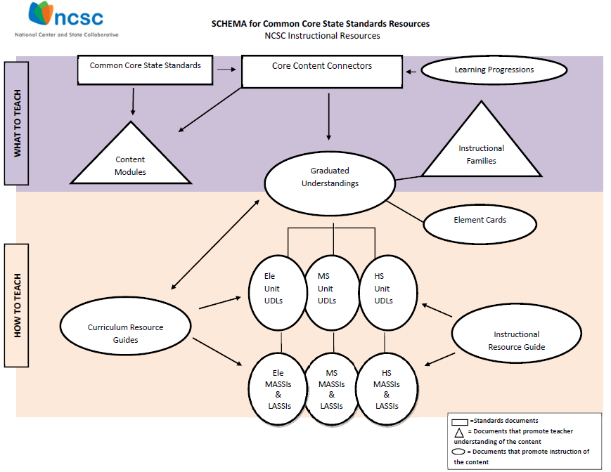
Notes:
Over the past several decades, powerful insights have been gained into how students represent knowledge and develop competence in specific domains, as well as how tasks and situations can be designed to provide evidence for inferences about what students know and can do for students across a full range of performance.
To provide evidence of student learning consistent with the increased expectations of the CCSS, the NCSC instructional resources schema defines the “what” and “how” when planning for and teaching academic content to students with the most significant cognitive disabilities.
In the schema, the purple band describes the “what to teach” containing the Common Core Sate Standards, the Core Content Connectors and the Learning Progressions.
In the schema, the orange band identifies instructional tools to support how to teach this content - based on over a decade of research on academic instruction, communication, and learner characteristics of students with the most significant cognitive disabilities.

Slide 22
Learning Progressions Framework (LPF)
Shows the steps students typically take to progress through a content area (e.g. math) to get deeper, broader, more sophisticated understanding,
Represents the essential core concepts and processes learned in a content area (sometimes called the “big ideas”);
Provides a map to IEP teams for what should come next as students continue to move through the grades; and
Contains progress indicators
Hess, Karin K., (December 2011). Learning Progressions Frameworks Designed for Use with the Common Core State Standards in English Language Arts & Literacy K-12.
Notes:
This project uses a developed learning progression framework (Hess et al., 2010) in ELA and math to inform what content is taught as well as the stream of content that helps students reach the concept/big idea;
The LPF is a hypothesized pathway that typical peers may take, and is meant to inform what typical peers will be working on grade by grade. In the past, we have struggled to understand how to choose content grade by grade to ensure inclusion of students with the most significant cognitive disabilities in grade AND age appropriate content even though they may not have built all the skills in a previous grade.
The LPFs give us the educational logic to help move these students along with their peers in a logical, educationally sound way.
The LPF contain learning targets and progress indicators that are referenced in C & I materials.
Learning targets(general/broad performance descriptors) are defined by grade spans, K-4, 5-8 an high school.
The related specific skills and concepts are called the progress indicators (PIs).
The Curriculum and Instructional materials were developed to help promote how students can engage in the CCSS while following the learning progressions.

Slide 23
Core Content Connectors (CCCs)
Using the learning progressions framework, NCSC identified the knowledge and skills from Common Core State Standards needed at each grade to make progress in later grades, but breaks them into smaller pieces called CCCs
CCCs are the basis for the NCSC assessment but operate as a starting point for instruction based on the CCSS
Notes:
The CCCs represent academic content designed to frame the instruction and assessment of students with the most significant cognitive disabilities in Kindergarten through high school while retaining the grade level content focus of the CCSS and the LPFs.
The CCCs preserve the sequence of learning outlined in the LPF to the extent possible while identifying the basic parts of the progress indicators into teachable and assessable segments of content.

Slide 24
Example:
CCSS- Read closely to determine what the text says explicitly and to make logical inferences from it; cite specific textual evidence when writing or speaking to support conclusions drawn from the text.
CCC- Ask and answer questions* about key details in a text.
*Instead of an oral or written response, some students may use picture symbols, character figures and props, etc.

Slide 25
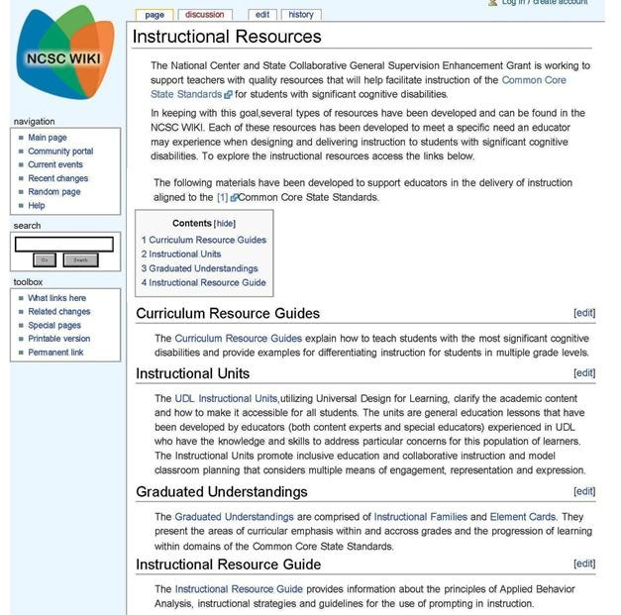
All curriculum and instructional resources available at https://wiki.ncscpartners.org
Notes:
The instructional resources tab of the NCSC wiki (an online tool developed collaboratively by a community of users like wikipedia) provides links to all the instructional resources in the “how to teach” section of the schema:
The Curriculum Resource Guides
Instructional Units
Graduated Understandings, housing both the Instructional Families and the Element Cards
The Instructional Resource Guide

Slide 26
NCSC Assessment

Slide 27
Assessment Participation Guidelines
There will be a NCSC AA-AAS in math and one in ELA, which includes both reading and writing, for grades 3-8 and 11
The IEP team will determine, on an individual basis, whether a student will take the NCSC AA-AAS
If a student doesn’t meet the AA-AAS criteria for both math and ELA, he/she may not be eligible for either AA-AAS

Slide 28
Format
Approximately 30 items for each subject.
These 30 items will cover approximately 10 CCCs
Most of the assessment items ask the student to select the correct response (e.g. multiple choice).
Some items will require the student to construct a response (e.g. write a short answer or use an alternate way to respond e.g. picture symbols)

Slide 29
Technology
This will be an online testing program.
Some students will use the online testing program directly on the computer.
For other students, the teacher may print out testing materials and enter student responses into the computer.
The assessment will have built-in supports to provide students with the opportunity to respond independently

Slide 30
Length of Assessment
Expected testing time will be approximately 1.5 – 2 hours for each assessment (math and ELA)
Each student’s assessment can be completed in multiple smaller time slots over a 2 month period to meet the student’s needs

Slide 31
Relationship of Items to Grade Level Content
About 75% of the assessment items are closely linked to the grade-level content
About 25% are a farther link to the grade-level content to allow students who are just beginning to work with the academic content show what they know and can do
In the first years of the new assessment many students will likely answer questions and do tasks that are less complex, but increase complexity as instruction improves

Slide 32
Exceptional Circumstances
There will be policies and criteria for dealing with rare situations where it may not be appropriate to administer or continue an assessment
When these policies are used there will be requirements for data collection in order to flag the need for interventions to address unmet instructional needs (e.g., related services or instructional supports)

