Slide 1
“College and Career Readiness” for Students with the Most Significant Cognitive Disabilities
June 2014

Slide 2
Parent Resources

Slide 3
NCSC Discussion of College and Career Readiness for Students with Significant Cognitive Disabilities
Discusses the relevance and importance of “college and career readiness” (CCR) for students with significant cognitive disabilities (which NCSC defines to include community readiness)
Demonstrates that typical CCR skills are related to critical skills for success and independence in the community
Addresses the role played by communicative competence with respect to CCR and safety in the community

Slide 4
NCSC Summary of Policy Paper on College and Career Readiness for Students with Significant Cognitive Disabilities
Reviews findings from a paper by the National Alternate Assessment Center on CCR for students with significant cognitive disabilities http://www.naacpartners.org
Describes the NCSC framework of assessment, curriculum and instruction and how it relates to CCR
Describes additional elements of CCR that can’t be measured by assessment, but should be addressed by IEP teams
Original NCSC research paper and the summary are posted at http://www.ncscpartners.org/resources

Slide 5
Parent Resources
Additional materials designed to help inform parents about NCSC’s work and related issues can be found at http://www.ncscpartners.org/resources
Other topics are:
A summary of the project
The NCSC assessment
The NCSC curriculum/ instructional resources
Communicative competence
Research on instruction/ assessment of students with significant cognitive disabilities

Slide 6
Background Information

Slide 7
NCSC Background
In 2010, the U.S. Department of Education awarded the National Center and State Collaborative (NCSC) a grant to develop a new alternate assessment on alternate academic achievement standards (AA-AAS) in math and English Language Arts by the 2014-15 school year*
24 states and five national organizations are working together in NCSC http://www.ncscpartners.org
NCSC is also developing curriculum/instructional resources based on Common Core State Standards (CCSS) that can be used in any state https://wiki.ncscpartners.org
* states may have different implementation timelines for NCSC assessment

Slide 8
Common Core State Standards (CCSS)
Define what students are expected to know and do for each grade level in math and English language arts (ELA)
Focus on what is most essential, not all that can or should be taught or “how” to teach
Are linked to expectations for college and career success
Most states have adopted the CCSS and must provide instruction and assessments for ALL students based on these standards.
The other states have similar college and career ready standards and related assessments
Notes:
NCSC promotes an opportunity to ensure that students with the most significant cognitive disabilities benefit from the national movement toward Common Core State Standards designed to prepare all students for success in college and careers (and community).
NCSC supports educators as they plan for and provide appropriate instruction that is based on the Common Core State Standards (CCSS) in English Language Arts (reading and writing) and mathematics in grades K – 8 and high school.
The Common Core State Standards intentionally leave room to determine how academic goals should be reached and what additional topics should be addressed.
The Curriculum and Instruction (C & I) resources provide evidenced-based strategies and tools to support how to teach this content that are based on over a decade of research on academic instruction, communication, and learner characteristics of students with the most significant cognitive disabilities.

Slide 9
NCSC’s Value in States Without CCSS
The main focus of any set of academic standards addresses similar content in math and ELA (e.g. equations, elements of fiction)
The NCSC resources are not meant to “be” the curriculum – they are models of curriculum and instructional resources that happen to be based on the CCSS
These models also demonstrate how to develop curriculum and instructional resources based on whatever standards a state is using
The richness of the NCSC resources for students with significant cognitive disabilities and their usefulness for professional development are valuable in any state

Slide 10
Career
College
Community
Curriculum
Common Standards
Learning Progressions
Core Content Connectors
Instruction
Grade-level Lessons
Accommodations
Systematic Instruction (carefully planned sequence for instruction)
Assessment
Formative (ongoing during school year, monitors learning)
Summative (end of year or course, evaluates learning)
Communicative Competence
NCSC Framework for Assessment and Curriculum/Instructional Materials
Notes:
Each component of the triangle (curriculum, instruction and assessment) is used to inform the other components which are all directed toward the goal of College, Career, and Community readiness.
In order for any student to benefit from challenging curriculum and high quality instruction, he or she has to be able to communicate what they know and can do. Communicative Competence is the base. Consistent communication intervention is needed to ensure that students can access the content.
Over the past several decades, powerful insights have been gained into how students represent knowledge and develop competence in specific content areas, as well as how tasks and situations can be designed to provide evidence for inferences about what students know and can do for students across a full range of performance.
Researchers are finding strong evidence of academic skill and knowledge development among students who participate in the alternate assessment for students with significant cognitive disabilities, including abstract concepts and application of learning.

Slide 11
NCSC Framework for Assessments, Curriculum and Instruction
College and career readiness in the NCSC model also includes community readiness
NCSC approach is to build assessments as a component of a broader system in which curriculum, instruction and assessments are closely linked
NCSC has developed curriculum/instructional resources for teachers
The framework is built on a foundation of communicative competence, so students have a reliable way to receive information from others and to show others what they know

Slide 12
College and Career Readiness

Slide 13
Increasing Numbers of Students with Intellectual Disabilities Are Going To College
The Higher Education Opportunity Act (2008) includes two major provisions that may facilitate entry into higher education for students with an intellectual disability.
Implementation of model demonstration sites
Availability of financial aid if enrolled
See www.thinkcollege.net for more information on the variety of programs that have been developed (many before 2008)

Slide 14
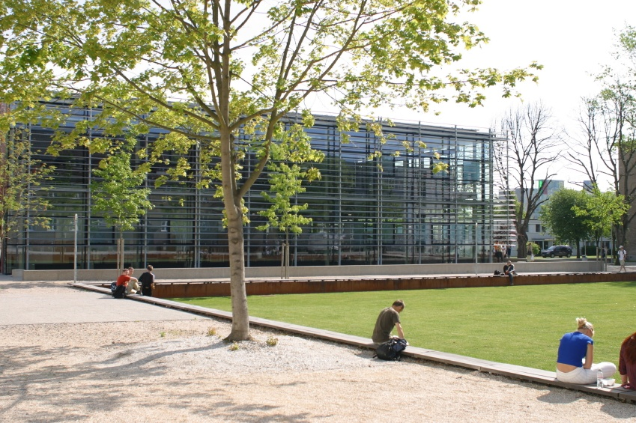
Postsecondary College Programs are About Opportunities
Academic and instructional
Employment/Career: Pathways to competitive employment
Independent living/residential
Social: An avenue for inclusion into one’s community
Notes:
Like all education, postsecondary education is about providing students with opportunities to learn and practice their learning. Therefore, college programs for students with ID need to explore:
academic instruction supported by peer tutoring, mentoring, and coaching
employment/career options through practicum and internship opportunities and including vocational rehabilitation professionals in these discussions as well as utilizing the services provided through the campus career center
Ultimately, transitioning to postsecondary education is stressful for the general education population and may be all the more stressful for individuals with intellectual disability. Therefore, the programs need to consider:
independent living/residential options and strategies as well as social strategies to help students adjust to college life and adult living in regards to the pressures and stresses students face socially as well as academically

Slide 15
Cross walking College and Career Readiness
All kids
Key Cognitive Strategies
Problem solving, reasoning, analysis, interpretation, critical thinking
Key Content
Reading, Math, Science, Social Studies
Academic Behaviors
Self monitoring, time management, using information resources, social interaction skills, working in groups
Contextual Skills and Awareness
Seeking help with admissions, procedures, career development
(Conley, 2007)
Students with Significant Cognitive Disabilities
Academic Access
Career Development
Social Network
Self Determination
Integration with College Systems & Practices
Coordination and Collaboration
Notes:
You can see the clear relationship between college and career readiness skills that apply to all students and the skills that students with significant cognitive disabilities need for successful post-school outcomes.

Slide 16
Which Skills Promote College and Career (and Community) Readiness?
Communicative competence
Social skills to function well in small groups
Independent work behaviors
Problem Solving
Reading/writing/math
Assistance seeking behaviors
Notes:
Communicative competence means to be provided with a communication system that enables the student to express personal needs and share information, ideas, questions, and comments about daily life and the world in which they live. Communicative competence is necessary in order to have access to the curriculum.

Slide 17
Working towards College and Career Readiness in English Language Arts is Important for ….
Communicating with family, friends, support staff, medical personnel, co-workers, etc.
Comparing information to make decisions (including voting)
Self-determination and self-advocacy
Traveling in the community
Understanding books, movies, TV shows and songs
Attending college
Finding and maintaining employment
Notes:
Regardless of student’s ability level or post-school goals there are benefits that can be derived from academic instruction.

Slide 18
Working towards College and Career Readiness in Math is Important for…
Telling time
Making and following a schedule
Managing money
Arranging and using transportation
Taking medication
Planning and making meals
Shopping
Attending college
Finding and maintaining employment

Slide 19
Remember…
Functional skills can be taught as part of academic lessons
The learning process itself results in benefits
e.g. critical thinking and problem solving
College and career ready skills are important for life in the community, regardless of a student’s post-school goals
The least dangerous assumption -exposing students to learning is not harmful; however keeping them from it is

Slide 20
Importance of College and Career Ready Skills for Success in the Community
Without college and career ready skills, students with significant cognitive disabilities will likely:
need greater supports throughout their life
live and work in more segregated environments
have more difficulty finding/keeping employment
have more difficulty learning about and engaging in community activities
be easier to victimize

Slide 21
Additional Elements of College and Career Readiness
Alternate assessments measure the academic knowledge and skills that students need for college and career readiness.
However, there are other important elements of college and career readiness that should also be addressed by IEP teams.
Research has found that these elements predict success after high school.

Slide 22
List of Additional Elements
Self-determination skills-should be taught as part of academic lessons
Student involvement in the IEP planning process- opportunities to practice self-determination skills should be maximized
Community-based vocational (job) training and paid employment while in school (including after school and summer jobs)
Community-based instruction-should include typical peers and should not take the place of general education classroom instruction

Slide 23
List of Additional Elements
Inclusion in general education classes
Social interaction skills and opportunities for peers support and friendship
Knowledge of one’s own support needs
Interagency transition collaboration-e.g. the school district and the adult services agencies working together to provide creative job development and on-going supports

