Slide 1
NCSC Curriculum and Instructional Resources
August 2014

Slide 2
Background

Slide 3
NCSC Background
In 2010, the U.S. Department of Education chose the National Center and State Collaborative (NCSC) as one of two consortia to develop new alternate assessments in math and English Language Arts by 2014-15*
24 states and five national centers are working together in NCSC http://www.ncscpartners.org/
NCSC is also developing curriculum/instructional resources based on Common Core State Standards that can be used in any state https://wiki.ncscpartners.org
*states may have different implementation timelines for
NCSC assessment

Slide 4
NCSC and Common Core State Standards(CCSS)
NCSC works to ensure that students with significant cognitive disabilities benefit from the national movement toward the CCSS
NCSC Curriculum and Instructional resources provide evidenced-based strategies and tools to support how to teach the CCSS to students with significant cognitive disabilities.
Notes:
NCSC supports educators as they plan for and provide appropriate instruction that is based on the Common Core State Standards (CCSS) in English Language Arts (reading and writing) and mathematics in grades K – 8 and high school.
The Common Core State Standards intentionally leave room to determine how academic goals should be reached and what additional topics should be addressed.
The Curriculum and Instruction (C & I) resources provide evidenced-based strategies and tools to support how to teach this content that are based on over a decade of research on academic instruction, communication, and learner characteristics of students with the most significant cognitive disabilities.

Slide 5
NCSC’s Value in States Without CCSS
The main focus of any set of academic standards addresses similar content in math and ELA (e.g. equations, elements of fiction)
The NCSC resources are not meant to “be” the curriculum – they are models of curriculum and instructional resources that happen to be based on the CCSS
These models also demonstrate how to develop curriculum and instructional resources based on whatever standards a state is using
The richness of the NCSC resources for students with significant cognitive disabilities and their usefulness for professional development are valuable in any state

Slide 6
NCSC Model
(Applies to Math and English Language Arts)

Slide 7

Career
College
Community
Curriculum
Common Standards
Learning Progressions
Core Content Connectors
Instruction
Grade-level Lessons
Accommodations
Systematic Instruction (carefully planned sequence for instruction)
Assessment
Formative (ongoing during school year, monitors learning)
Summative (end of year or course, evaluates learning)
Communicative Competence
NCSC Framework for Assessment and Curriculum/Instructional Materials
Notes:
Each component of the triangle (curriculum, instruction and assessment) is used to inform the other components which are all directed toward the goal of College, Career, and Community readiness.
In order for any student to benefit from challenging curriculum and high quality instruction, he or she has to be able to communicate what they know and can do. Communicative Competence is the base. Consistent communication intervention is needed to ensure that students can access the content.
Over the past several decades, powerful insights have been gained into how students represent knowledge and develop competence in specific content areas, as well as how tasks and situations can be designed to provide evidence for inferences about what students know and can do for students across a full range of performance.
Researchers are finding strong evidence of academic skill and knowledge development among students who participate in the alternate assessment for students with significant cognitive disabilities, including abstract concepts and application of learning.

Slide 8
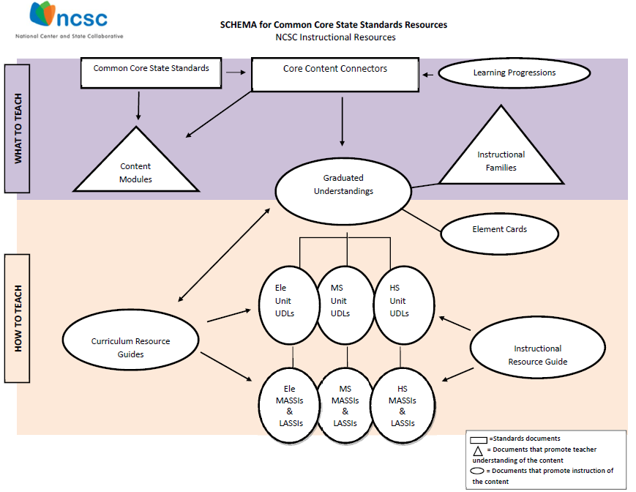
Notes:
Over the past several decades, powerful insights have been gained into how students represent knowledge and develop competence in specific domains, as well as how tasks and situations can be designed to provide evidence for inferences about what students know and can do for students across a full range of performance.
To provide evidence of student learning consistent with the increased expectations of the CCSS, the NCSC instructional resources schema defines the “what” and “how” when planning for and teaching academic content to students with the most significant cognitive disabilities.
In the schema, the purple band describes the “what to teach” containing the Common Core Sate Standards, the Core Content Connectors and the Learning Progressions.
In the schema, the orange band identifies instructional tools to support how to teach this content - based on over a decade of research on academic instruction, communication, and learner characteristics of students with the most significant cognitive disabilities.

Slide 9
NCSC Background Information

Slide 10
Learning Progressions Framework (LPF)
There is a typical path that learning takes in order to make academic progress through the grades and get a deeper, more sophisticated understanding of the content,
The Learning Progressions Framework shows the steps on that path (learning targets), which are the essential core knowledge and skills in the content areas; sometimes called the “big ideas”
Notes:
This project uses a developed learning progression framework (Hess et al., 2010) in ELA and math to inform what content is taught as well as the stream of content that helps students reach the concept/big idea;
The LPF is a hypothesized pathway that typical peers may take, and is meant to inform what typical peers will be working on grade by grade. In the past, we have struggled to understand how to choose content grade by grade to ensure inclusion of students with the most significant cognitive disabilities in grade AND age appropriate content even though they may not have built all the skills in a previous grade.
The LPFs give us the educational logic to help move these students along with their peers in a logical, educationally sound way.
The LPF contain learning targets and progress indicators that are referenced in C & I materials.
Learning targets(general/broad performance descriptors) are defined by grade spans, K-4, 5-8 an high school.
The related specific skills and concepts are called the progress indicators (PIs).
The Curriculum and Instructional materials were developed to help promote how students can engage in the CCSS while following the learning progressions.

Slide 11
Core Content Connectors (CCCs)
Using the learning progressions framework, NCSC identified the knowledge and skills from Common Core State Standards needed at each grade to make progress in later grades, but breaks them into smaller pieces called CCCs
CCCs are the basis for the NCSC assessment but operate as a starting point for instruction based on the CCSS
Notes:
The CCCs represent academic content designed to frame the instruction and assessment of students with the most significant cognitive disabilities in Kindergarten through high school while retaining the grade level content focus of the CCSS and the LPFs.
The CCCs preserve the sequence of learning outlined in the LPF to the extent possible while identifying the basic parts of the progress indicators into teachable and assessable segments of content.

Slide 12
CCC Example
Common Core State Standard- Read closely to determine what the text says explicitly and to make logical inferences from it; cite specific textual evidence when writing or speaking to support conclusions drawn from the text.
CCC- Ask and answer questions* about key details in a text.
*Instead of an oral or written response, some students may use picture symbols, character figures and props, etc.

Slide 13
Learning Progression Framework
Curriculum Application
Lesson 5
Using CCCs in a lesson for broad range of learners
Area
Find area of quadrilaterals
Find area of plane figures and surface area of solid figures (quadrilaterals)
Describe the changes in surface area, area, and volume when the figure is changed in some way (e.g., scale drawings)
Graphing
Locate the x and y axis on a graph
Locate points on a graph
Use order pairs to graph given points
Solve Linear Equations
Solve a linear equation to find a missing attribute given the area, surface area, or volume and the other attribute
Fractions
Partition circles and rectangles into two and four equal parts
Partition shapes into equal parts with equal area
Ratio & Proportion
Solve problems that use proportional reasoning with ratios of length and area
Describe the changes in surface area, area, and volume when the figure is changed in some way (e.g., scale drawings)
Apply formulas
Solve word problems using perimeter and area where changes occur to the dimensions of a figure
CCCs = that connect skills
Area
Use addition to find the perimeter of a rectangle
Use tiling and multiplication to determine area
CCCs=Sub-skills that develop conceptual understanding
Basic operations
Addition
Subtraction,
Multiplication
Division
CCCs =Prerequisite knowledge or emergent skills
Part to Whole
Partition circles and rectangles into two equal parts
Notes:
This slide is an example of how CCCs can be combined in a lesson to deepen and broaden understanding for a broad range of learners, starting with CCCs for prerequisite and emergent skills and knowledge working up to CCC’s that connect skills.
Instructional Families represent “bundles” of related CCCs that have a common instructional basis. Hence, these bundles may be taught within a an Instructional Unit. It is critical to use a holistic approach to teaching the CCCs rather than a discrete or one-by-one checklist approach.

Slide 14
Content Modules
Online multimedia resources;
Provide teachers with a deeper understanding of content to support effective planning, teaching, and learning;
Include sample universally designed general education lesson plans and participant assessments; and
Describe potential adaptations and modifications for designing materials and instruction
Notes:
Content modules help teachers who need greater understanding of the content.

Slide 15
Curriculum Resource (CR) Guides
Provide guidance for teaching the CCSS to students with the most significant cognitive disabilities
Provide UDL tables with examples for making instruction accessible for a wide range of students
Provide ideas on how to promote college and career ready outcomes while teaching certain concepts
There are downloadable CR Guides for many math and ELA topics
Notes:
The Curriculum Resource Guides help teachers to better understand how to teach the CCCs.
Both the Content Modules and Curriculum Resource Guides were developed and validated by content experts and special educators with extensive experience in adapting general curriculum for students with significant cognitive disabilities.
The Curriculum Resource Guides describe how to teach the content to students with the most significant cognitive disabilities whereas the Content Modules describe the mathematics content (what is being taught) in general education.
Together, the Content Modules and the Curriculum Resource Guides provide teachers with the necessary background knowledge to prepare students for the NCSC alternate assessment and offer examples of how the content is taught in general education, ideas for real life use, examples of universal design for learning, and ways to promote college and career readiness.

Slide 16
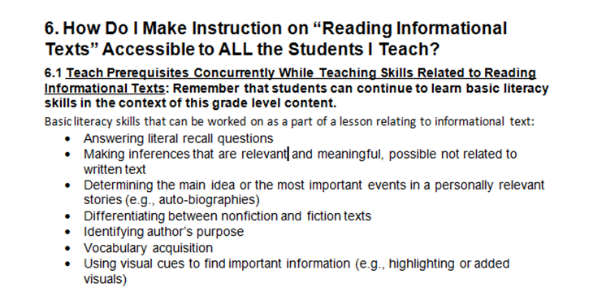
ELA Curriculum Resource Guide

Slide 17
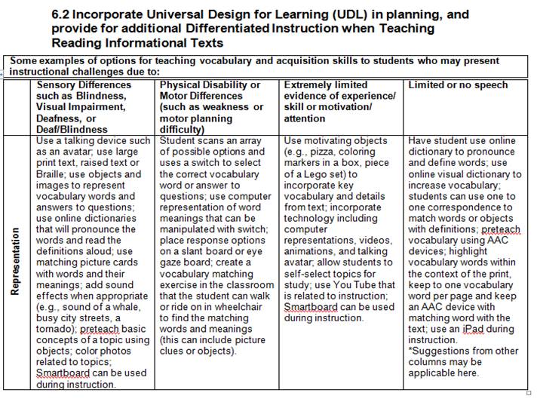

ELA Curriculum Resource Guide UDL Table

Slide 18
Curriculum Resource Guides
DRAFT
Notes:
Example of sample materials provided

Slide 19
Graduated Understandings: Instructional Families
Put related CCCs into families
Provides educators with different views of how instructional families develop and interact across all the grades and across a grade band (e.g. Elementary School)
Notes:
Represents “what” should be learned. It isn’t important for purposes of this presentation to understand all the details on the following charts—just understand that they help educators process how learning progresses for related CCCs so that they build the needed foundation for future learning

Slide 20
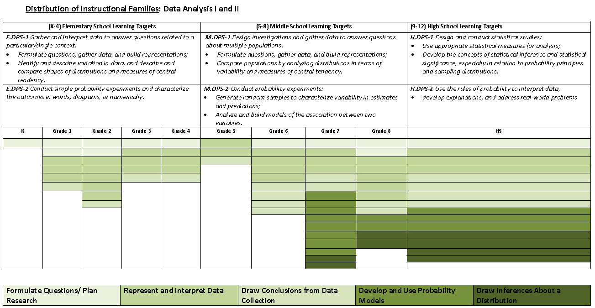
Grade-span Learning Targets from the Learning Progression Frameworks
Distribution of Instructional Families and the number of related CCCs by grade
Five Instructional families for Data Analysis I & II
Notes:
The first view of the instructional families is a chart that illustrates the distribution and changes in emphasis of the core content, knowledge and skills that students with the most significant cognitive disabilities are expected to learn at each grade to promote success in the next grade and to reach the learning targets within the LPF and the CCSS.
As shown, the distribution of families and the number of CCCs in each family in a domain by grade clearly varies across grades k – high school.
This sample view of Data Analysis I and II (DPS-1 and DPS-2) also connects the learning targets of the Learning Progressions Frameworks to the distribution of the Instructional Families and CCCs. Note that the Learning Targets become more sophisticated as you move up through the grades and that the emphasis (distribution of instructional families) changes as well.
Students are expected to build their knowledge and be successful with more challenging concepts across the grade levels (for example, from representing and interpreting data toward drawing inferences about a distribution of data). Student mastery of skills at each grade level promotes student learning of more challenging concepts.
The view shows the distribution and emphasis of the five instructional families and the number of related CCCs for Kindergarten through high school. For example, in grades 7 – HS, all five of the instructional families are indicated where as in grade 5, two instructional families are included.
Given that students may receive instruction in multi-grade classrooms, a teacher can quickly see where there is an “overlap” of instructional families across grades. The teacher can then plan instruction that addresses related content within and across families at appropriate levels of instruction for different students within the same lesson.

Slide 21
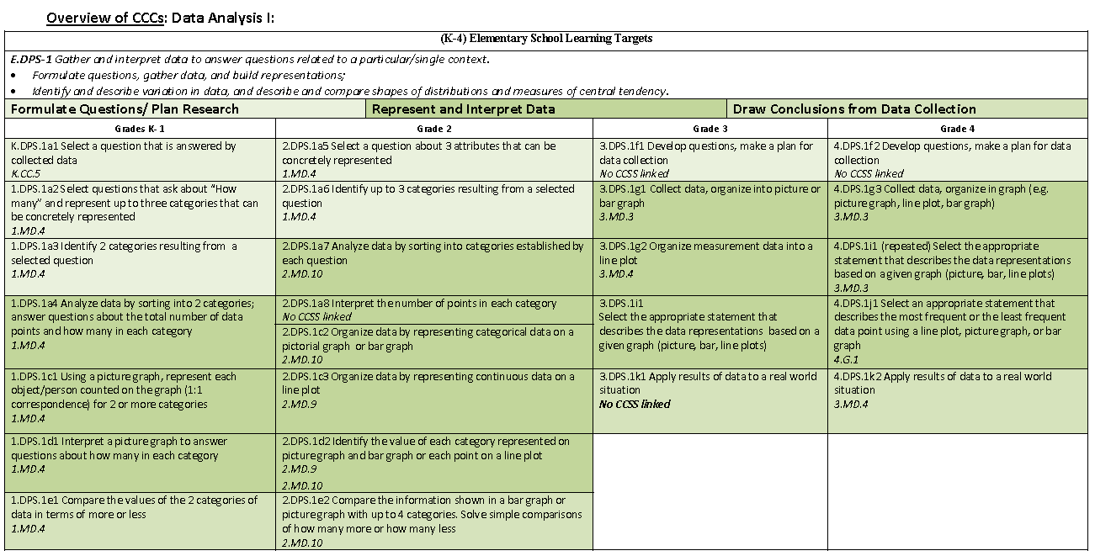

Grade-span Learning Target from the Learning Progression Frameworks
Instructional Families for Data Analysis I (K-4)
Reference to related CCSS
Distribution of CCCs by Instructional Families an grade
Notes:
This view of the instructional families illustrates the distribution of families and the specific CCCs in each family by grade-band (K-4). It also reflects the instructional families and CCCs’ relationship to the learning progressions by demonstrating the relationship to the elementary grade band learning target (big ideas). Additional charts in this view illustrate the overview of the CCCs by grade-bands 5 – 8 and high school.
There is a difference in the number of CCCs within a family within and across the grade levels. It clearly shows the instructional family emphasis and specific CCCs within and across grades K - 4.
In this example of the CCCs chart, the specific CCCs are indicated by families in the Strand of Data Analysis I (DPS-1).
Three of the Instructional Families in Data Analysis, Formulate Questions/ Plan Research; Represent & Interpret Data and Draw Conclusions from Data Collection, are shown. Notice the relationship between the three families at the five grade levels (K-4).
There is a difference in the number of CCCs within a family within and across the grade levels.
Note that for each CCC, there is a reference to the CCSS.

Slide 22
Graduated Understandings:
Element Cards
Provide a wide range of suggested instructional strategies and supports to promote instruction for students with diverse learning needs-including those without prior knowledge
Element cards are available for many CCCs but are meant to serve as models and to be used together with other NCSC instructional resources
Notes:
The Element cards, when used in combination with other NCSC CCSS instructional tools, define the “how” by providing ways in which teachers can address grade-specific academic content for students with SCD, even if students have not had an opportunity learn this content previously.

Slide 23
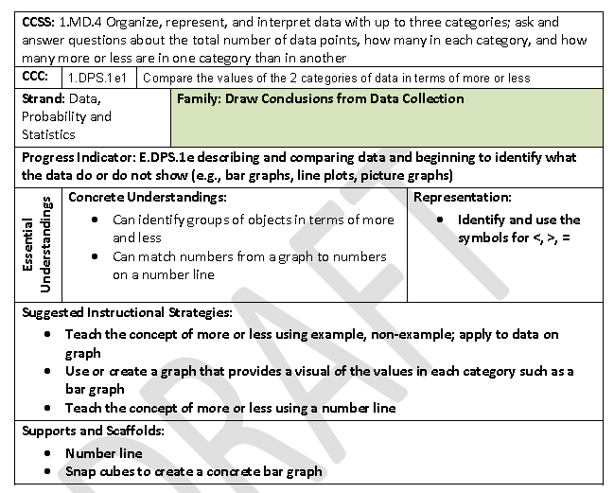
Notes:
The first component of the Element Card is the CCSS: This is the Common Core State Standard on which the CCC is based.
The second component is the Core Content Connector: The code used to identify the CCC is followed by a statement of the grade-specific CCC.
The third row provides the related LPF Strand followed by the Instructional Family that contains this CCC. In this example, the instructional family is Draws Conclusions from Data Collection.
The next row on this slide denotes the related Progress Indicator of the LPF.
The next row contains the Essential Understandings including Concrete and Representation.
Mathematical Concrete: Fundamental mathematical concepts and skills to address the content described in the grade-level CCCs.
Mathematical Representation: Specific symbols or referents related to the concepts and skills to apply when problem solving (e.g., mathematical symbols and operations of addition, subtraction, multiplication, division, fractions, equations).
The Suggested Instructional Strategies section provides examples of evidenced-based strategies supporting instruction at varying levels of challenge; and
The Supports and Scaffolds section provide suggestions of possible tools and materials that assist in the promotion of understanding and engagement with concepts. These suggested supports and scaffolds can provide a way for students to demonstrated what they know and can do.

Slide 24
UDL Instructional Units
  Universal Design for Learning (UDL) requires that students be provided with multiple ways to get information, multiple ways to demonstrate their knowledge and skills, and multiple ways to be engaged in learning www.udlcenter.org
  A UDL Unit:
  Includes general education lessons using UDL to provide access to the content for all students and promote inclusive instruction (should also be used to inform lessons in special education classes)
  Provides additional considerations for students who are emerging readers and emerging communicators
Notes:
Teaching requires designing instructional plans that promote learning for all students – whatever their entry point is into the content.
The Units and Lesson Plans provide models of universally designed planning for an entire class of students—to help educators learn to use UDL with all their lessons. The Units and Lesson Plans illustrate how to target the CCCs within general education lessons. Examples are provided for planning for engagement, representation, and expression to meet the unique needs of students with significant cognitive disabilities.
Description of Instructional Units:
Each of the NCSC instructional units is intended to be used to clarify what the academic content is, how it can be made more accessible for all students, and what units of study might look like when sequencing skills and concepts along a research-based learning continuum.
The units weave within the lessons those skills or points of critical understandings that a student with a significant cognitive disability may not have and may not have ever received instruction on in past grades

Slide 25
UDL Instructional Unit
  Provides data sheets and skills tests
  Links to additional, intensive interventions
  Contains:
  definitions of key vocabulary,
  lesson objectives,
  essential questions and materials, and
  lesson components (introduction of the lesson, direct instruction and/or facilitation of activities, practice, closure/review and exit assessment)
Notes:
UDL Lesson Components include:
Introducing the Lesson
Direct Instruction and/or Facilitation of Activities
Practice
Closure (review lesson and objectives)
Exit Assessment
Resources

Slide 26
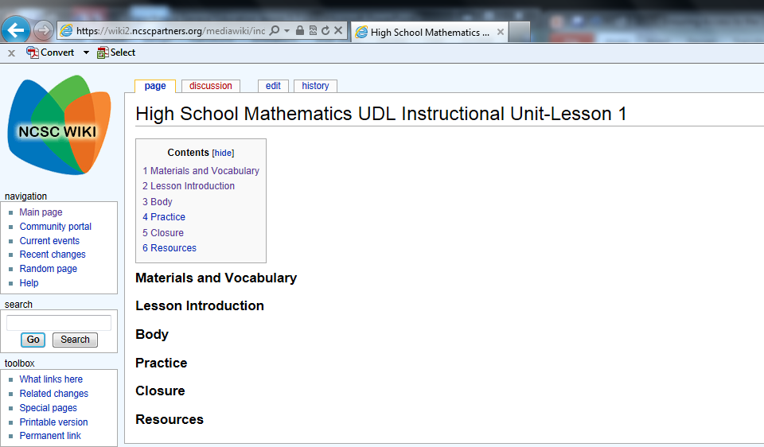
Lesson 1: Introduction – 10 minutes
A. Activate Previous Knowledge
Lead a short discussion about how to find perimeter and area of rectangles.
  Review with students the concepts of perimeter and area.
  Discuss how these concepts are used in real life examples.
    Example 1: A runner is practicing by running along the fence line of a parking lot. Is he running the perimeter of the parking lot or is he running the area?
Example 2: The school is getting new carpet in the classroom. Will the workers need to figure out the area of the classroom or the perimeter?
  Break class into small groups to answer exercises.
Using figures (rectangles and squares) drawn on grid paper or formed on Geoboards, find the perimeters and areas.
Remind students that answers should/must include the appropriate units of measure.
Multiple means of representation: Use models and/or drawings during large group instruction. Allow students to have a copy of a drawing or a model at their desks.
Multiple means of expression: Provide a list of formulas to determine area and perimeter or provide options for using manipulatives and/or computer models.
Multiple means of engagement: Allow students to use paper/pencil, manipulatives, computer, etc. to complete exercises.
https://wiki.ncscpartners.org
Notes:
View of one page of a UDL instructional unit on the wiki

Slide 27
Additional Considerations for Emerging Readers and Emerging Communicators
Provide picture and/or tactile representations of relevant vocabulary, paired with the written word, each time a salient concept/vocabulary word for rectangle, area, and perimeter is mentioned during the presentation or discussion, as well as the meanings of each word. Create math journals to record vocabulary, formulas, and notes. Provide the formulas for area and perimeter as the concepts of each are discussed. During discussion, provide picture representation of real world uses for area and perimeter. As students work in small groups or pairs, ensure they have a means for gaining their group members’ or partner’s attention and a means for contributing to the discussion. Students may use their math journals or a graphic organizer to collect/store information gathered during group. To find area and perimeter, use grid paper, count/mark/tally each unit along the length of the figure to determine length and count/mark/tally each unit along the width of the figure to determine the width. Use the formulas to determine area and perimeter. A list of formulas may be used by the student as a reference. Student may be presented with manipulatives of a unit and the rectangle drawn on grid paper. Students determine area and perimeter by placing the manipulative units on each unit around the rectangle on the grid paper to demonstrate perimeter as well as within the rectangle to demonstrate area. Using manipulatives may be demonstrated electronically, using a computer program or PowerPoint, to count units virtually to determine area and perimeter. See Resources: See PowerPoint, Slides 1 and 2. As answers are reviewed, be sure to reference the appropriate units of measure. For example, if students determine the perimeter of a 3inch by 4inch figure is 14, reply, “That is correct. It is 14 inches.” If they determine the area is 12, reply, “That is correct. It is 12 inches square.” Remind students to record the appropriate unit. Model how to write the appropriate units. Present students with an alternative representation of unit to record in their math journals or graphic organizers. Important Note for Communicators Considered Pre-Symbolic: Be sure students have a way to attain peer attention as well as to share and receive information. Limit measurements to one type: standard or metric unit.
Notes:
Additional considerations for emerging readers and emerging communicators are shared throughout the UDL lessons.

Slide 28
Math/ Language Activities for Scripted Systematic Instruction (MASSIs and LASSIs)
Activities for when students need more intensive instruction on particular key points or on missing prerequisite knowledge
Can be used in all educational settings, including general education classrooms
Incorporates evidence-based instruction from research, including faded prompting
Provides teaching scripts for educators who may not be familiar with the carefully planned steps of systematic instruction
Notes:
The MASSIs/LASSIs offer intensive instruction based on evidence-based practices known to be effective in teaching skills to mastery for students with the most significant cognitive disabilities.
They identify the concepts and symbols needed to move toward mastery of the Core Content Connectors.
Using scripts, the MASSIs and LASSIs present instruction in grades bands 3-5, 6-8 and high school and help teachers plan and prepare for instruction with suggested teacher and student materials.
They offer a guide for instruction with graduating levels of difficulty – ranging from the first steps of teaching the content to students with little or no understanding of the content to building understanding of the target concepts of the CCCs using real-life word problems and using hand-on activities aligned to grade-level content.
After teaching the UDL Instructional Units and utilizing the MASSIs and LASSIs as appropriate for individual students, teachers will gain practice in instructional strategies that are effective for teaching content to students with the most significant cognitive disabilities.

Slide 29
Instructional Resource Guide
Defines methods of prompting and feedback
Explanation of Instructional Strategies
Includes troubleshooting Q&A
Designed for use with MASSIs and LASSIs but can be used with UDL lessons, as well.
Notes:
The Instructional Resource Guide helps educators to build knowledge of essential, evidence-based systematic instructional methods and defines the use of these strategies that are used in the MASSIs and LASSIs to teach students targeted skills.

Slide 30
Professional Development
Communities of Practice in partner states received professional development about the curriculum and instructional resources via webinars that are publicly available at http://www.ncscpartners.org/resources-cop-presentations
States will also have access to interactive professional development modules

Slide 31
Educator Response-Favorable!
Sample quote:
“I have had the pleasure of observing several classrooms across the state of Indiana where NCSC materials are being implemented on a daily basis. Wow! The impact is powerful, students are responsive, and teachers are dedicated to increased academic achievement.”
Amy Howie, Project SUCCESS* Director
*Project SUCCESS is an Indiana resource center that supports high academic achievement for students with disabilities.

Slide 32
NCSC Wiki –Publicly Available https://wiki.ncscpartners.org
The wiki hosts the NCSC materials that educators will need to deliver instruction to students with significant cognitive disabilities
There are four links at the top of the home page:
Curriculum Resources
Instructional Resources
Classroom Solutions (solutions or accommodations created by educators and shared here)– coming soon
All Resources A browser bar where you can click directly on the type of document that you wish to view

Slide 33
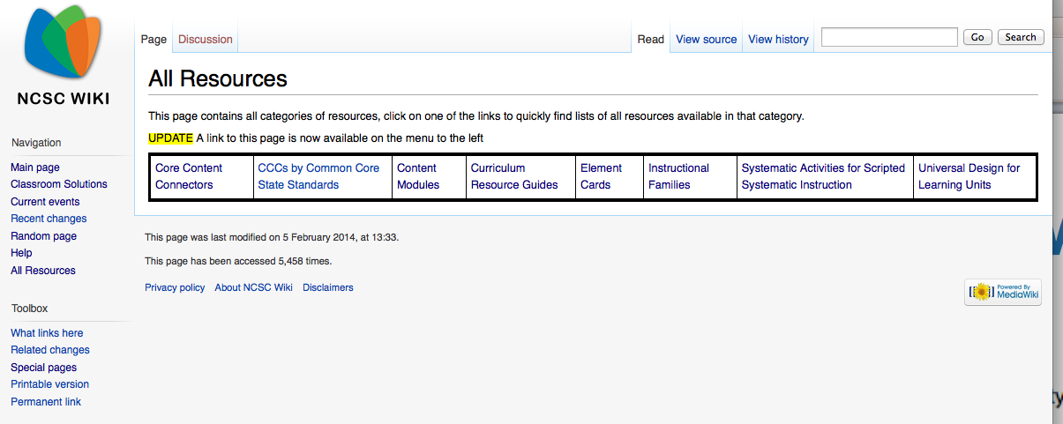
The wiki Main Page
Notes:
The all resources link takes you to a clickable table of each type of resource. If you know which category you are looking for, you can go right there.

Slide 34

Finding what you need
Use the search bar in the top right corner of the wiki page to search for content within the wiki.
“Go” assumes you know the exact name of the page or document, search will bring up internet-like search results.

Slide 35


Tools and aids within the wiki
Look for links at the bottom of the page to printable materials that can be used with the NCSC resources, or for links to printable versions of the online content.
Look for link at the top of the page to return you to primary pages.

